Slide 1
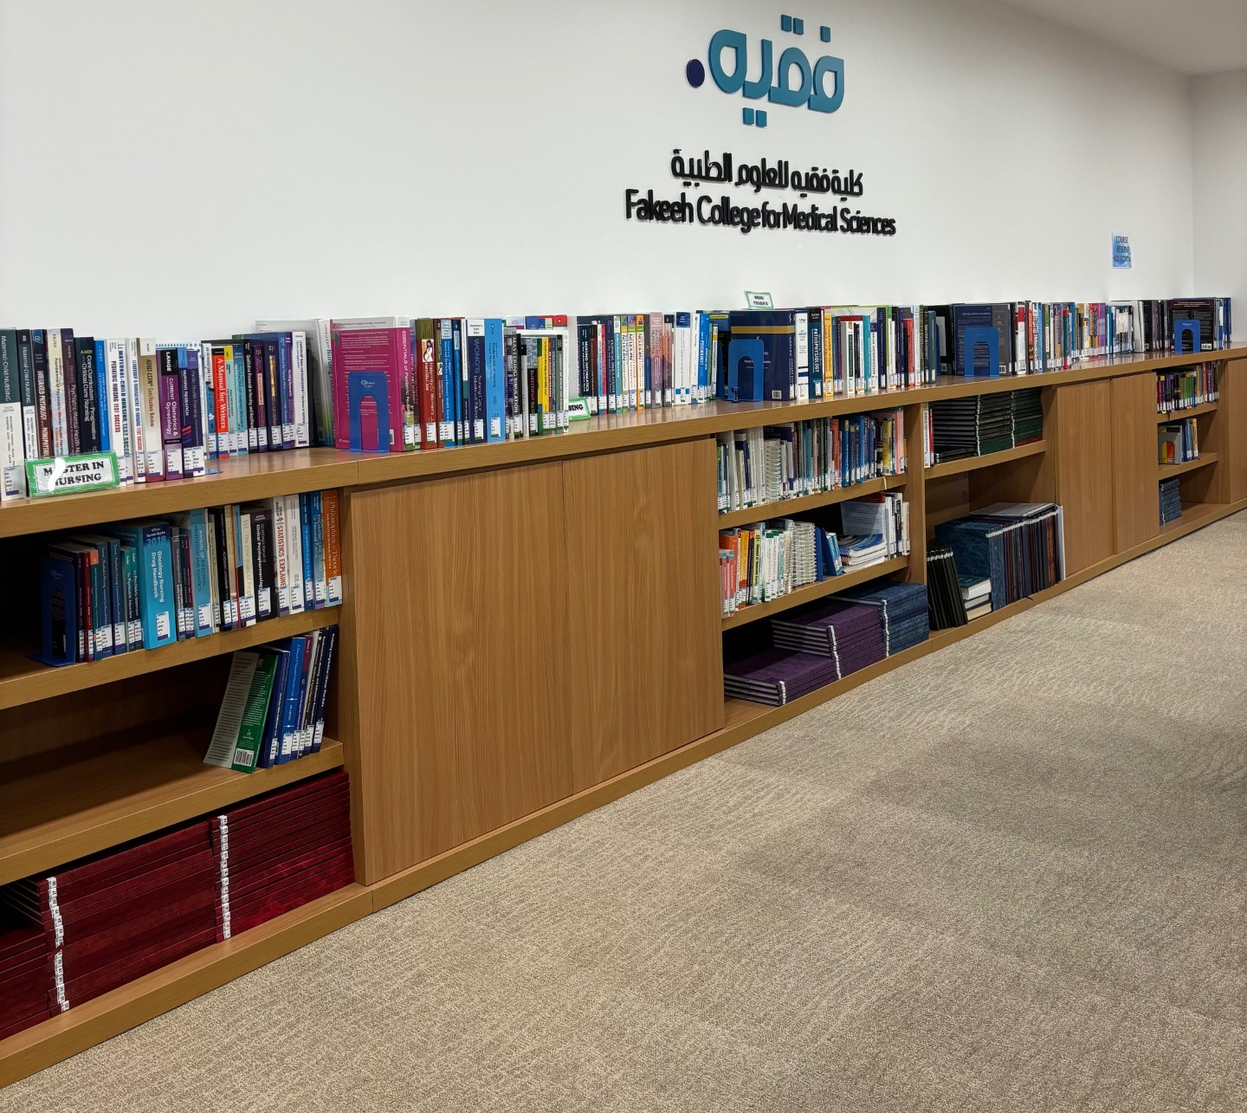
Library Portal
A Guide on how to conduct a search through FCMS Digital Library

Slide 2
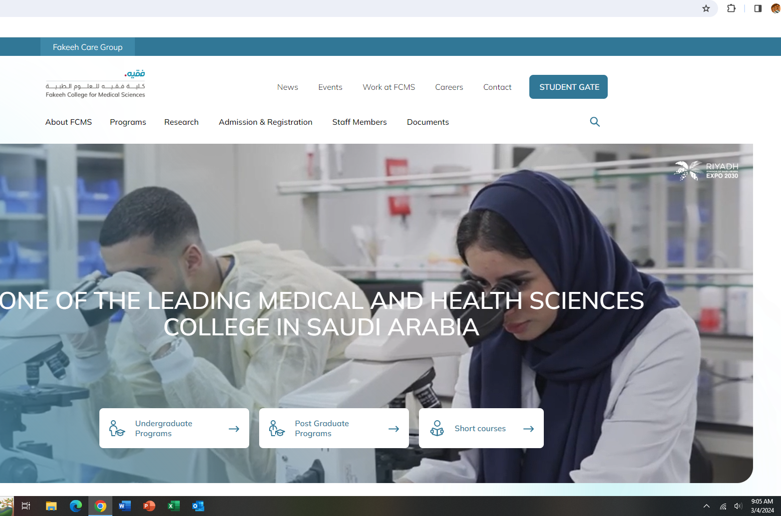
Step 1
Go to Fakeeh College Website:
www.fakeehcollege.edu.sa

Slide 3
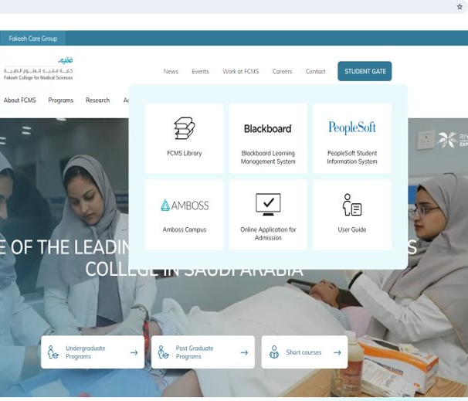

Step 2
Go to FCMS Library Portal.

Slide 4
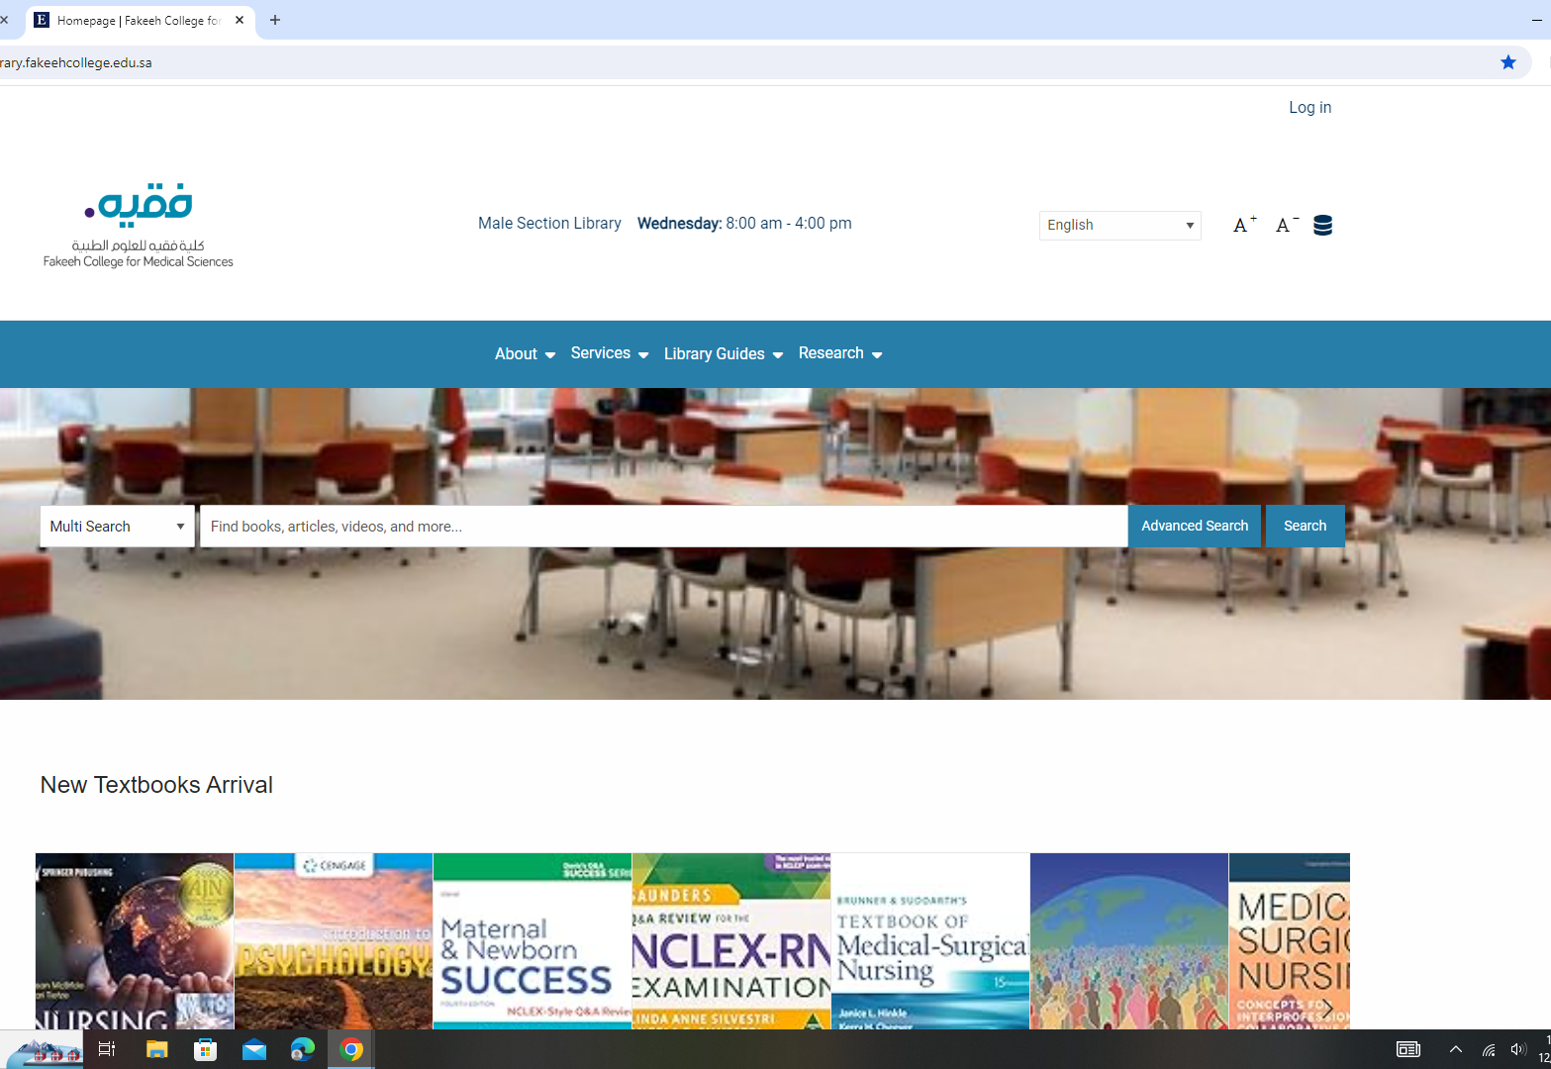
Step 3:
Open the Library Portal or you can go directly to the Library's website at:
www.library.fakeehcollege.edu.sa

Slide 5
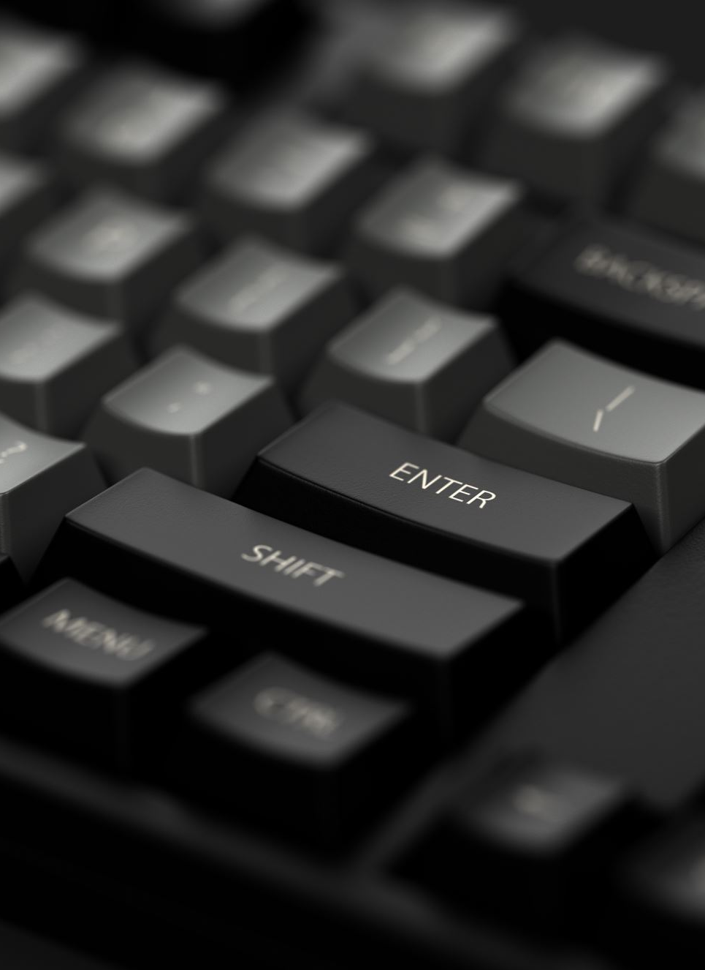
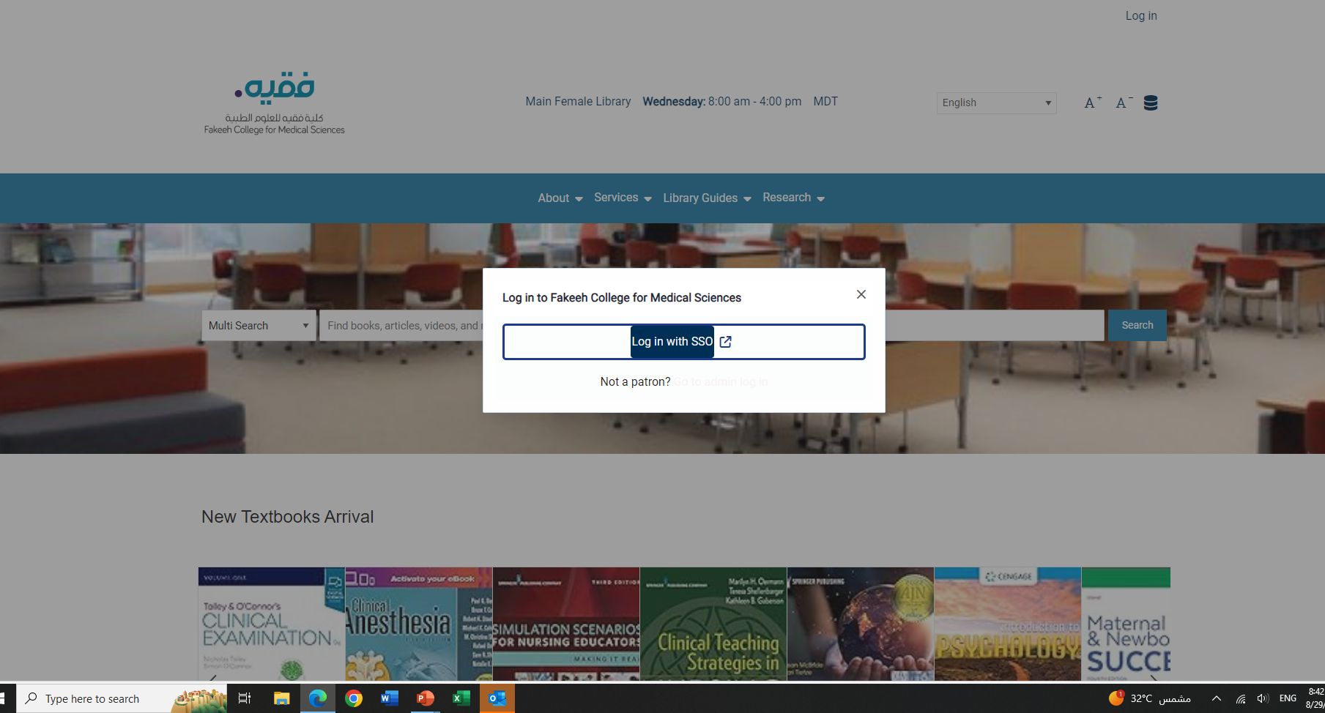

Step 4: Log in
Press Log in as shown.
Press Log in with SSO.
Go to step 5 in the next slide.

Slide 6

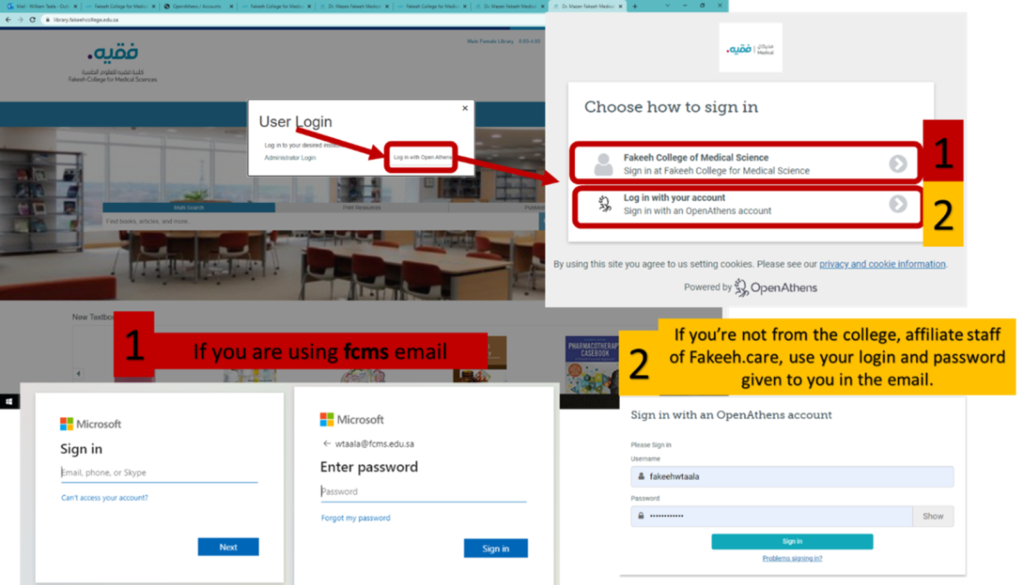
Step 5: Log in

Slide 7

How to search for a topic:

Slide 8
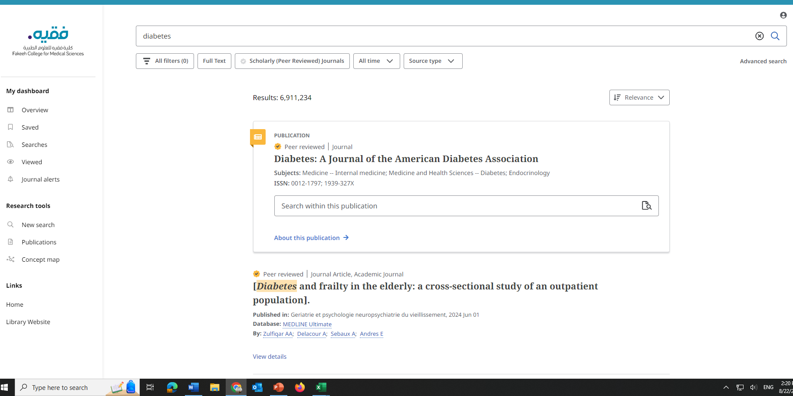

Step 1:
Insert your research terms in the search bar.
For Example: I want to search for this topic: “Diabetes"
I type the name of the topic and press search.
Diabetes

Slide 9
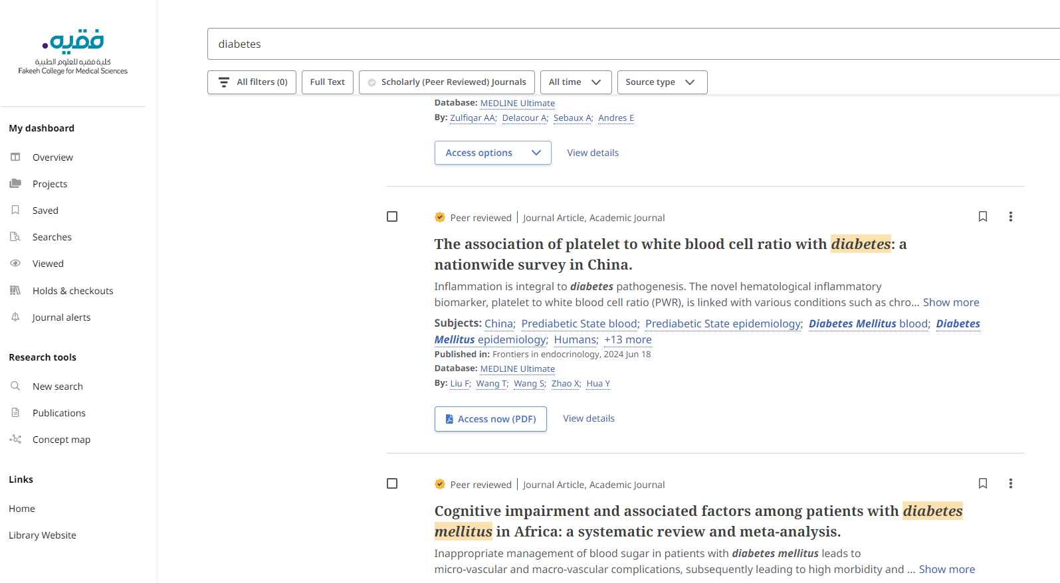

Step 2:
After Browsing, choose the articles that you want to read online or print.
For example: I like this article, so I press on Access Now (PDF).

Slide 10
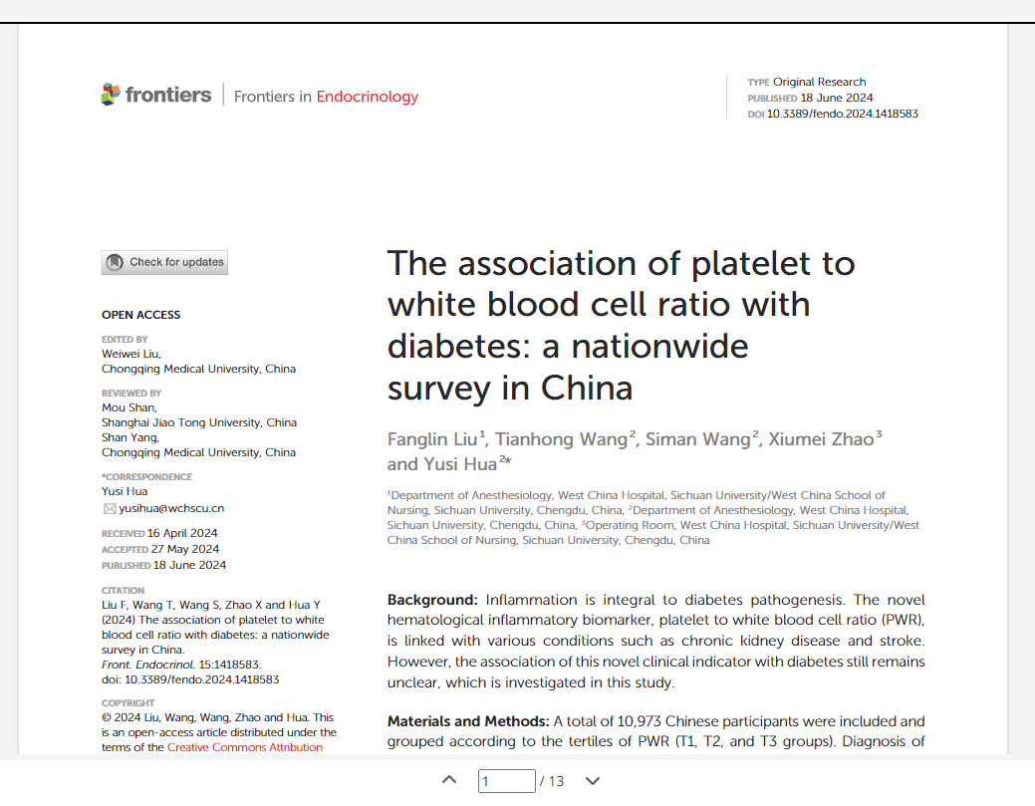
Step 3:
Download the article as shown in the picture.
You can then either read it online, download it or print it.

Slide 11

Please Note
Sometimes the articles you are looking for are not accessible through the FCMS Digital Library for reading or retrieving. In that case consider looking for a related article.

Slide 12

End of Demo
The previous slides demonstrates the steps you need to follow to search the FCMS Digital Library.
For More assistance do not hesitate to contact Library Staff. We will be happy to assist you.

Slide 13
Thank You
Library Hours: SUNDAY TO THURSDAY 8:00 AM TO 4:00 PM
Phone:
+966 12 6588650 Extension 601
For any questions please Don’t hesitate to talk to our library team @fcms
Ms. Amal
Ms. JENIE
Ms. Hanan
Mr. Riyad
aoalmansouri@fcms.edu.sa
jspasigna@fcms.edu.sa
hfalsayegh@fcms.edu.sa
rhklamri@fcms.edu.sa

